Slide 1
Workshop Webapp Development
Using Spring Boot MVC

Slide 2
Today’s Topic
Add a webpage to the project using Thymeleaf templating Engine

Slide 3
What is MVC?
Spring Framework
Request
Controller
Data
Thymeleaf
Template
Webpage

Slide 4
Add a simple Home Page
Reconfigure pom.xml
spring-boot-starter-thymeleaf
Add a html file to /resources/templates folder.
Add a Controller object to the project.
Use RequestMapping and GetMapping to map the request to the Java method.
Return a webpage to the request.

Slide 5
Passing Data using Model object
Use addAttribute() of the Model object to transfer data to the webpage.
Access to model attribute in the HTML template using ${}.
Variable Expressions: ${...}
Selection Variable Expressions: *{...}
Message Expressions: #{...}
Link URL Expressions: @{...}
Fragment Expressions: ~{...}

Slide 6
Add a Hero List Page
Add a GetMapping to the controller to map “/all” endpoint to a Java method. Return a Hero List Page with a model of list of heroes.
Create a new HTML template for Hero List Page. Use th:each property in <tr> to iterate the list.

Slide 7
Create a Add Hero Page
Add a GetMapping to the controller to map “/add” endpoint to a Java method. Return an Add Hero Page with a new empty model.
Create a new HTML template for Add Hero Page.
Use th:object property to bind the <form> to the model.
Use th:field property to bind the <input> element of the <form>.
Use th:action to set the endpoint to the POST request.
Add a PostMapping to the controller to map “/add” endpoint.
This endpoint access the data from the HTML using ModelAttribute.
The endpoint update the database and return a response web page.
th:action=”@{url}” th:object=”${object}” th:field=”*{name}”

Slide 8
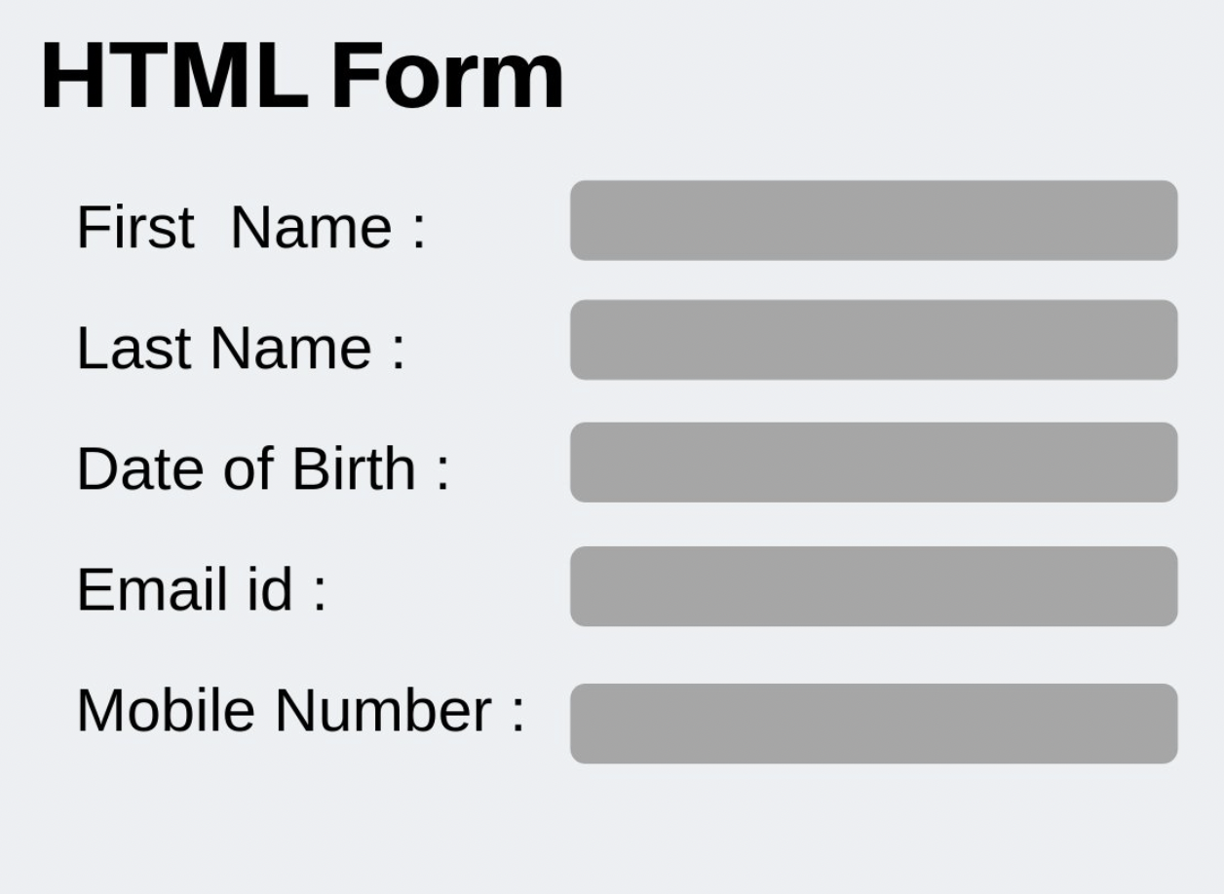
Add Hero Process
Spring Framework
GET
Controller
Model
Thymeleaf
Template
Add Hero Page
Spring Framework
POST
Controller
Database
Thymeleaf
Template
Home Page

